Slide 1

Active Noise Cancellation Using the LMS algorithms
Team Members:
R.prashant 2k18/EC/124
Raghav Goel 2k18/EC/126

Slide 2
Background and Motivation
Let’s start at the beginning

Slide 3
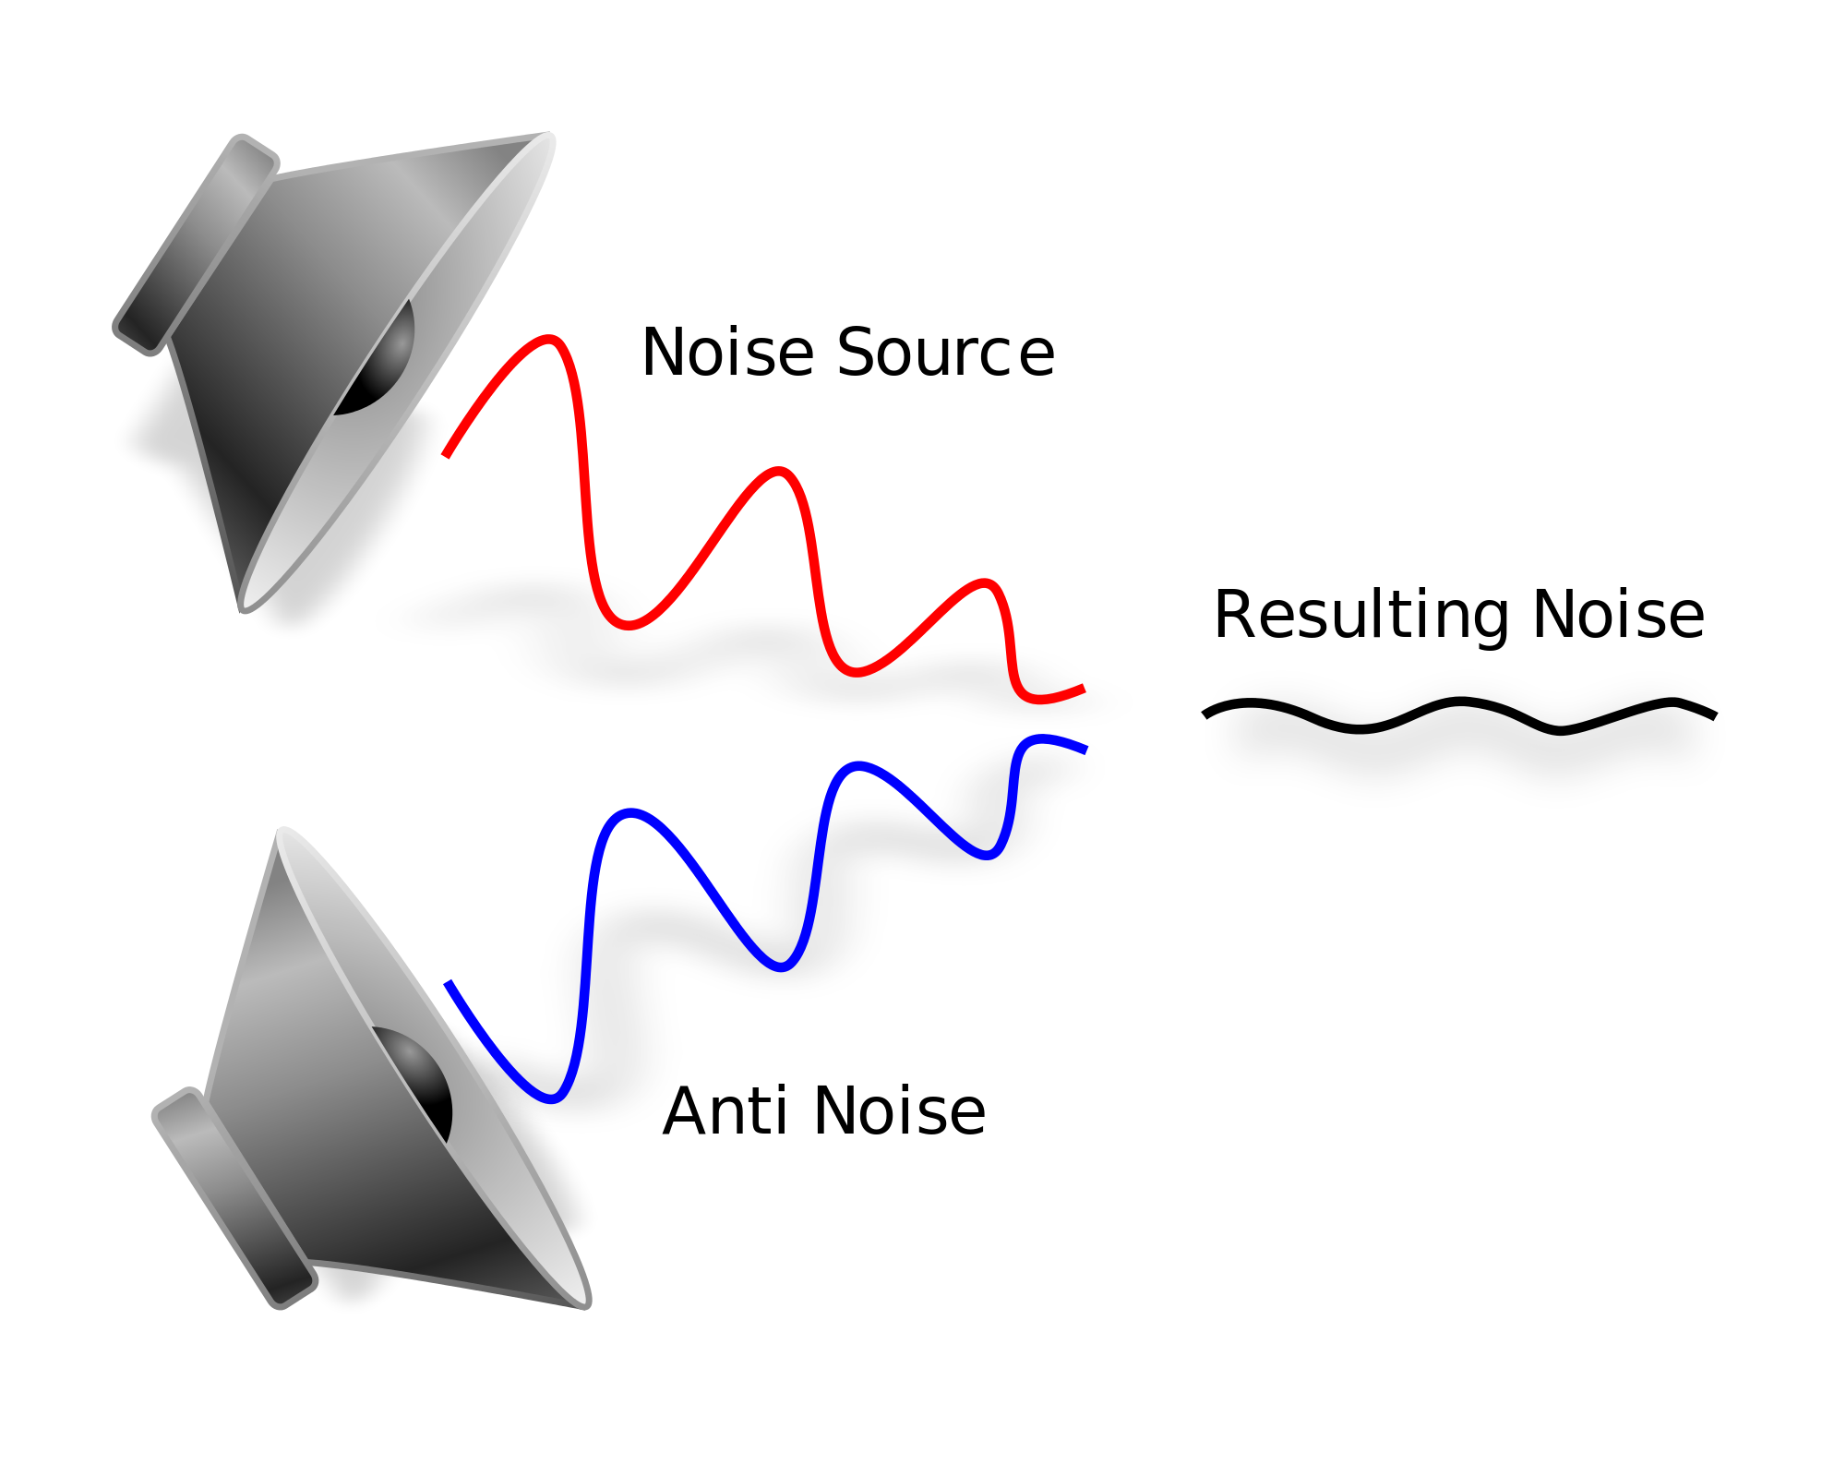
Background
Active Noise Cancellation (ANC)
Technique which uses destructive interference to cancel unwanted noise signals.
Machine learning algorithms are employed to quickly learn the characteristics of the unwanted signal in near real time.

Slide 4
System Overview
Equations & block diagrams ahead

Slide 5
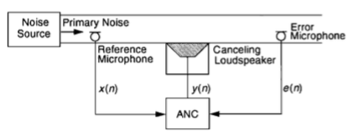
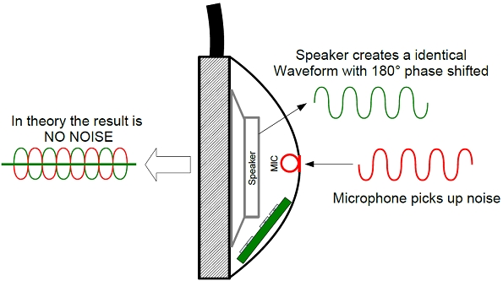
Conceptual System Overview

Slide 6
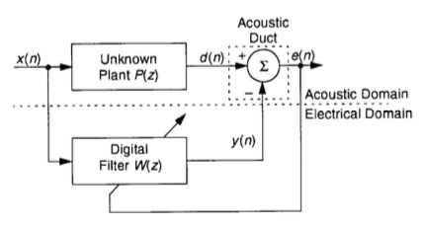
LMS for ANC Block Diagram
Unknown plant P(z) is the transfer function b/w engine and passenger in car our outside world and ears in headphones.
As e(n) approaches 0, W(z) becomes equal to P(z)

Slide 7
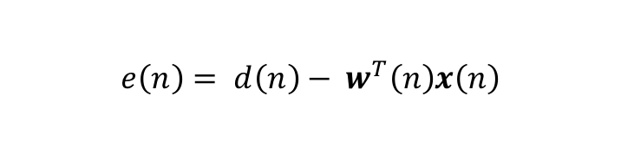
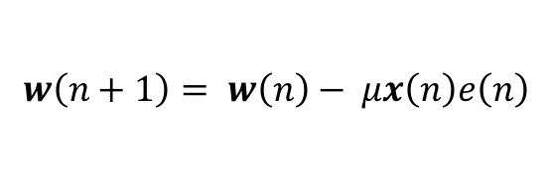
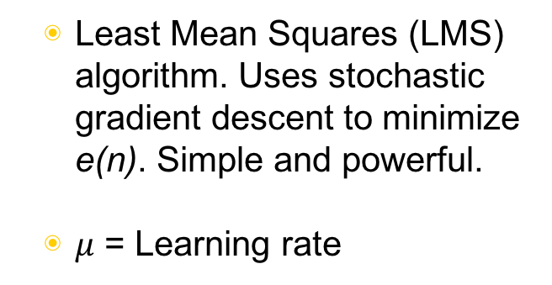
LMS for ANC Equations

Slide 8

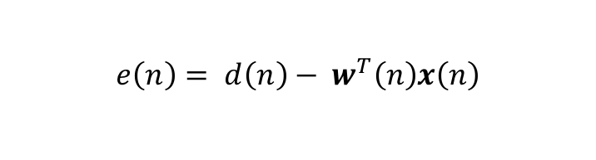
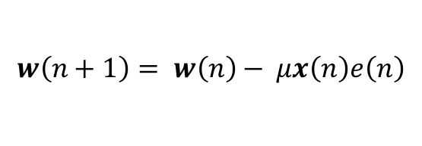
LMS for ANC Block Diagram and Equations
error e(n)

Slide 9
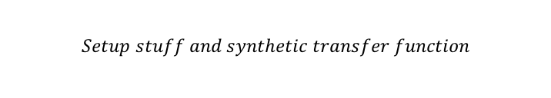
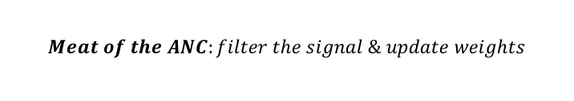
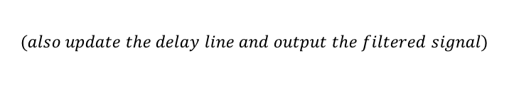
code
yn=0.0;
x[0] = refnoise;
for (i = 0; i < N; i++) // compute adaptive filter output (w'x)
{
yn += (weights[i] * x[i]);
}
error = - yn; // compute error
for (i = N-1; i >= 0; i--) // update weights and delay line
{
weights[i] = weights[i] + mu*error*x[i];
x[i] = x[i-1];
}
codec_data.channel[LEFT]= ((uint16_t)(error));
codec_data.channel[RIGHT]= ((uint16_t)(error));
output_sample(codec_data.uint);
return;
}
interrupt void interrupt4(void)
{
short i;
float input, refnoise, signal, signoise, wn, yn, error;
codec_data.uint = input_sample();
refnoise =(codec_data.channel[LEFT]); // noise sensor
input = refnoise;
for (i=0; i < N; i++)
// filter refnoise to emulate transfer
// function of firewall (3rd order lp filter)
{
wn = input - a[i][1]*w[i][0] - a[i][2]*w[i][1];
yn = b[i][0]*wn + b[i][1]*w[i][0] + b[i][2]*w[i][1];
w[i][1] = w[i][0];
w[i][0] = wn;
input = yn;
}

Slide 10
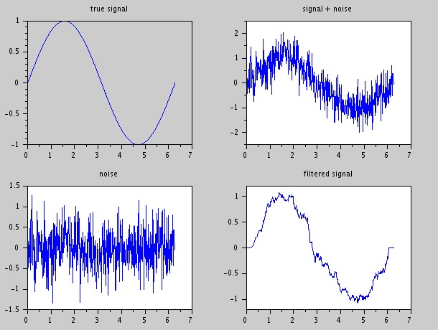
Experiment results so far

Slide 11
Future Work
A lot of research has been done in the field of improving the noise cancellation using various algorithms.Our future objective is to explore such new algorithm and improve upon the existing one with tweaks in the original one .

Slide 12
Thanks!
.

